Slide 1
Introduction to AI
Uninformed Search

Slide 2
Topic & Structure of The Lesson
Uninformed Search
Breadth First Search
Depth First Search

Slide 3
Types of Searching
Uninformed search – breadth first search & depth first search
Informed search – A* search and hill climbing

Slide 4
Learning Outcomes
At the end of this topic, You should be able to
Introduction to Uninformed Search
State Space
Breadth first Search
Depth first search

Slide 5
Key Terms You Must Be Able To Use
If you have mastered this topic, you should be able to use the following terms correctly in your assignments and exams:
Root
Branch
Breadth first search
Depth first search

Slide 6
Problem solving by search
The solution to a problem in AI can be represented by a series of choices.
Ex : in a game the first move can be choice of several moves, each of these moves then leads to a choice of second move and so on.
In a complex AI problem , the number of possible moves can quickly grow to millions and million of combinations when looking as little as ten moves ahead
Notes:
Whoever it may be (humans or AI) need to think of all possible ways to reach the goal state(if it exists) from the initial state, all the consequences, etc. Similarly, AI systems use various search algorithms for a particular goal state(if it exists).
As the name ‘Uninformed Search’ means the machine blindly follows the algorithm regardless of whether right or wrong, efficient or in-efficient.These algorithms are brute force operations, and they don’t have extra information about the search space; the only information they have is on how to traverse or visit the nodes in the tree.
Thus uninformed search algorithms are also called blind search algorithms. The search algorithm produces the search tree without using any domain knowledge, which is a brute force in nature. They don’t have any background information on how to approach the goal or whatsoever. But these are the basics of search algorithms in AI.

Slide 7
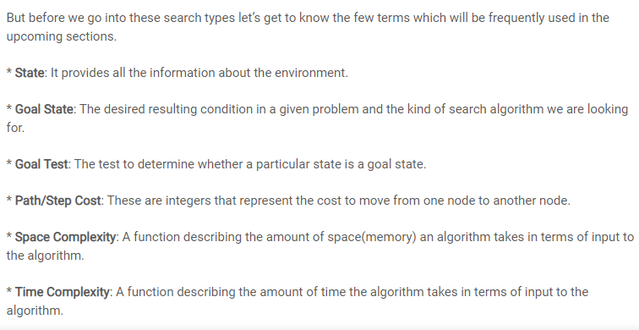
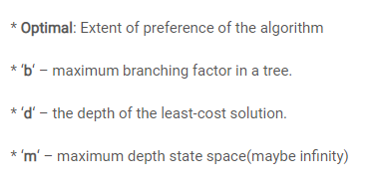

Slide 8
Uninformed Search
Uninformed search is a class of general-purpose search algorithms which operates in brute force-way.
Uninformed search algorithms do not have additional information about state or search space other than how to traverse the tree, so it is also called blind search.

Slide 9
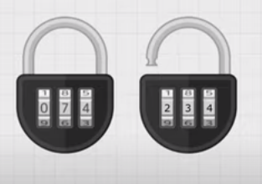
Problem
You forgot the number to open – what will you. You will try all possible no – max combination 1000.

Slide 10
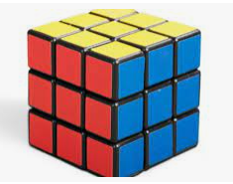
Problem 2 – Brute force method
How to solve rubric cube – it will take so many trials and you will repeat some of it?

Slide 11
Brute Force ?
Is a method that will find the answer 100%
So programmer need to think all the possible way to find the solution
But need to use the optimization

Slide 12
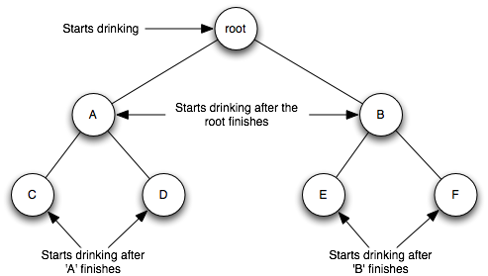
Search Techniques
Construction of a simple search tree

Slide 13
Single-state problem formulation
A problem is defined by four items:
1. initial state
2. actions or successor function
3. goal test,
4. path cost (additive)

Slide 14
Search and Problem Solving
Search problems described in terms of:
An initial state.
A target state.
Some possible actions, that get you from one state to another.
Search techniques systematically consider all possible action sequences to find a path from the initial to target state.

Slide 15
Simple Example
Easiest to first look at simple examples based on searching for route on a map.
How do we systematically and exhaustively search possible routes, in order to find, say, route from library to university?
School
Factory
Hospital
Newsagent
Library
church
Park
University

Slide 16
Search Space
The set of all possible states reachable from the initial state defines the search space.
We can represent the search space as a tree.
We refer to nodes connected to and “under” a node in the tree as “successor nodes”.
library
school
hospital
factory
park
newsagent
university
church

Slide 17
Simple Search Techniques
How do we search this tree to find a possible route from library to University?
May use simple systematic search techniques, which try every possibility in systematic way.
Breadth first search - Try shortest paths first.
Depth first search - Follow a path as far as it goes, and when reach dead end, backup and try last encountered alternative.

Slide 18
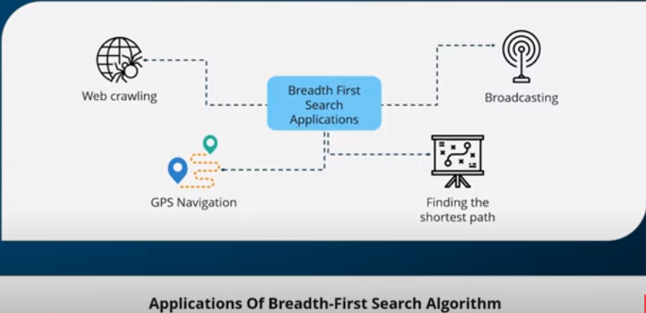

Slide 19
Breadth first search
AI programs use a problem solving techniques which examines all solution until a match is found
In this search techniques each horizontal layer – starting with top level of the search tree is searched from left to right in turn. The order of visiting the elements

Slide 20
Breadth first search
Explore nodes in tree order: library, school, hospital, factory, park, newsagent, uni, church. (conventionally explore left to right at each level)
library
Goal :church using breadth search
Library, school, hospital, factory, park , newsagent , university, church.
Data structure : Queue - FIFO
school
hospital
park
newsagent
factory
university
church
Goal : hospital
Library, school, hospital

Slide 21
Summary BFS
Breadth-first search is the most common search strategy for traversing a tree or graph. This algorithm searches breadthwise in a tree or graph, so it is called breadth-first search.
BFS algorithm starts searching from the root node of the tree and expands all successor node at the current level before moving to nodes of next level.
The breadth-first search algorithm is an example of a general-graph search algorithm.
Breadth-first search implemented using FIFO queue data structure.

Slide 22
Advantage BFS
BFS will provide a solution if any solution exists.
If there are more than one solutions for a given problem, then BFS will provide the minimal solution which requires the least number of steps.

Slide 23
Disadvantage BFS
It requires lots of memory since each level of the tree must be saved into memory to expand the next level.
BFS needs lots of time if the solution is far away from the root node.

Slide 24
Time Complexity
Time Complexity of BFS algorithm can be obtained by the number of nodes traversed in BFS until the shallowest Node. Where the d= depth of shallowest solution and b is a node at every state.

Slide 25
Space Complexity
Space complexity of BFS algorithm is given by the Memory size of frontier which is O(bd).

Slide 26
Completeness
BFS is complete, which means if the shallowest goal node is at some finite depth, then BFS will find a solution.

Slide 27
Optimality:
BFS is optimal if path cost is a non-decreasing function of the depth of the node.

Slide 28
Depth first search
This search techniques starts with the left hand side of the search tree and searches down a branch until a solutions found
If a solution is not found by the end of the branch then the search backtracks to the last place where there was a choice of paths
And the search is made down the next branch and so n
The order of visiting the elements of the search tree

Slide 29
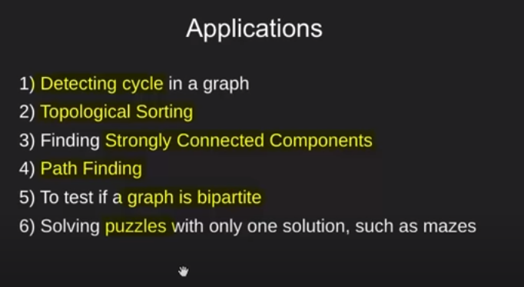
DFS applications

Slide 30
Depth first search
Strawberry
Vanila
chocolate
Nodes explored in order: library, school, factory, hospital, park, newsagent, university
library
school
hospital
park
newsagent
factory
university
church

Slide 31
Summary DFS
Depth-first search isa recursive algorithm for traversing a tree or graph data structure.
It is called the depth-first search because it starts from the root node and follows each path to its greatest depth node before moving to the next path.
DFS uses a stack data structure for its implementation.
The process of the DFS algorithm is similar to the BFS algorithm.
Note: Backtracking is an algorithm technique for finding all possible solutions using recursion.

Slide 32
Advantage
DFS requires very less memory as it only needs to store a stack of the nodes on the path from root node to the current node.
It takes less time to reach to the goal node than BFS algorithm (if it traverses in the right path).

Slide 33
Disadvantage:
There is the possibility that many states keep re-occurring, and there is no guarantee of finding the solution.
DFS algorithm goes for deep down searching and sometime it may go to the infinite loop.

Slide 34
Completeness:
DFS search algorithm is complete within finite state space as it will expand every node within a limited search tree.

Slide 35
Time Complexity
Time complexity of DFS will be equivalent to the node traversed by the algorithm. It is given by:

Slide 36
Space Complexity
: DFS algorithm needs to store only single path from the root node, hence space complexity of DFS is equivalent to the size of the fringe set, which is O(bm).

Slide 37
Optimal
: DFS search algorithm is non-optimal, as it may generate a large number of steps or high cost to reach to the goal node.

Slide 38
Algorithms for breadth first and depth first search.
Very easy to implement algorithms to do these kinds of search.
Both algorithms keep track of the list of nodes found, but for which routes from them have yet to be considered.
E.g., [school, hospital] -have found school and hospital in tree, but not yet considered the nodes connected to these.
List is sometimes referred to as an agenda. But implemented using stack for depth first, queue for breadth first.

Slide 39
Tutorial
camel
monkey
Lion
Giraffe
Elephant
Rhinoceros
Polar bear
kangaroo

Slide 40
Question
Breath first search : Camel , monkey, elephant, lion, giraffe, rhinoceros, polar bear , kangaroo
Depth first search : Camel, monkey, lion , giraffe, kangaroo, elephant, rhinoceros , polar bear

Slide 41
Algorithm for breadth first
Start with queue = [initial-state] and found=FALSE.
While queue not empty and not found do:
Remove the first node N from queue.
If N is a goal state, then found = TRUE.
Find all the successor nodes of N, and put them on the end of the queue.
FIFO - Queue

Slide 42
Algorithm for depth first
Start with stack = [initial-state] and found=FALSE.
While stack not empty and not found do:
Remove the first node N from stack.
If N is a goal state, then found = TRUE.
Find all the successor nodes of N, and put them on the top of the stack.
LIFO - stack

Slide 43
Extensions to basic algorithm
Loops: What if there are loops (ie, we are search a graph)? How do you avoid (virtually) driving round and round in circles?
Algorithm should keep track of which nodes have already been explored, and avoid redoing these nodes.
Returning the path: How do you get it to actually tell you what the path it has found is!
One way: Make an item on the agenda be a path, rather than a node.

Slide 44
Heuristic search algorithms
Depth first and breadth first search turn out to be too inefficient for really complex problems.
Instead we turn to “heuristic search” methods, which don’t search the whole search space, but focus on promising areas.
Simplest is best first search. We define some “heuristic evaluation function” to say roughly how close a node is to our target.

Slide 45
Summary of Main Teaching Points
Best-first search is general search where the minimum-cost nodes (according to some measure) are expanded first.
Greedy search uses minimal estimated cost h(n) to the goal state as measure. This reduces the search time, but the algorithm is neither complete nor optimal

Slide 46
Summary on Searching
Please refer to word document and tutorial

Slide 47
Question and Answer Session
Q & A

